Slide 1
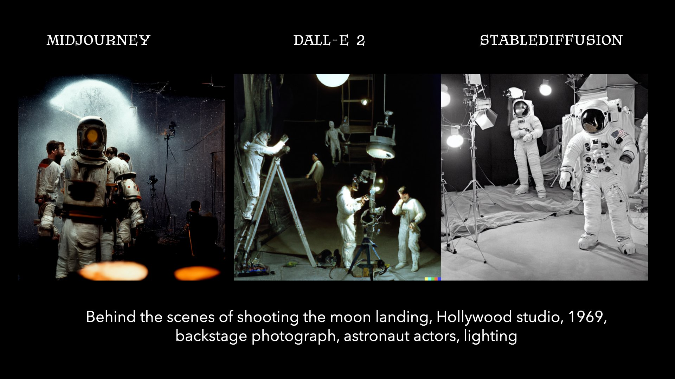
GenAI: Image

Slide 2
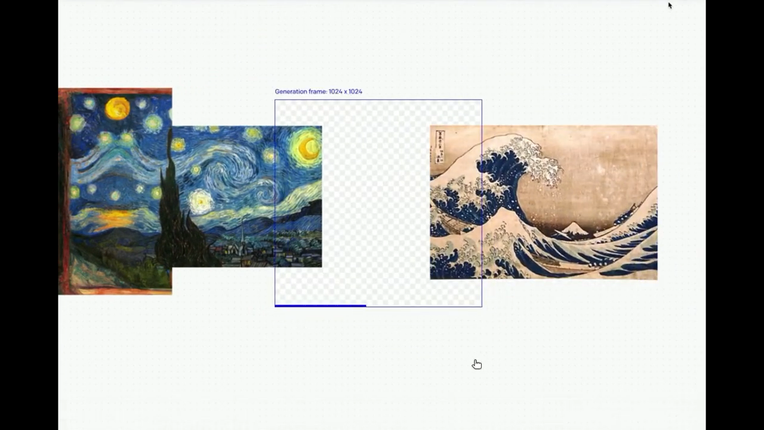
GenAI: Image
Out-painting by DALL-E 2
(Van Gogh, Monet, Monch, Hokusai)

Slide 3
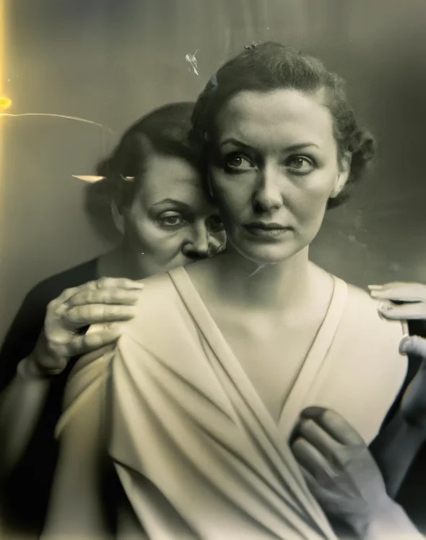
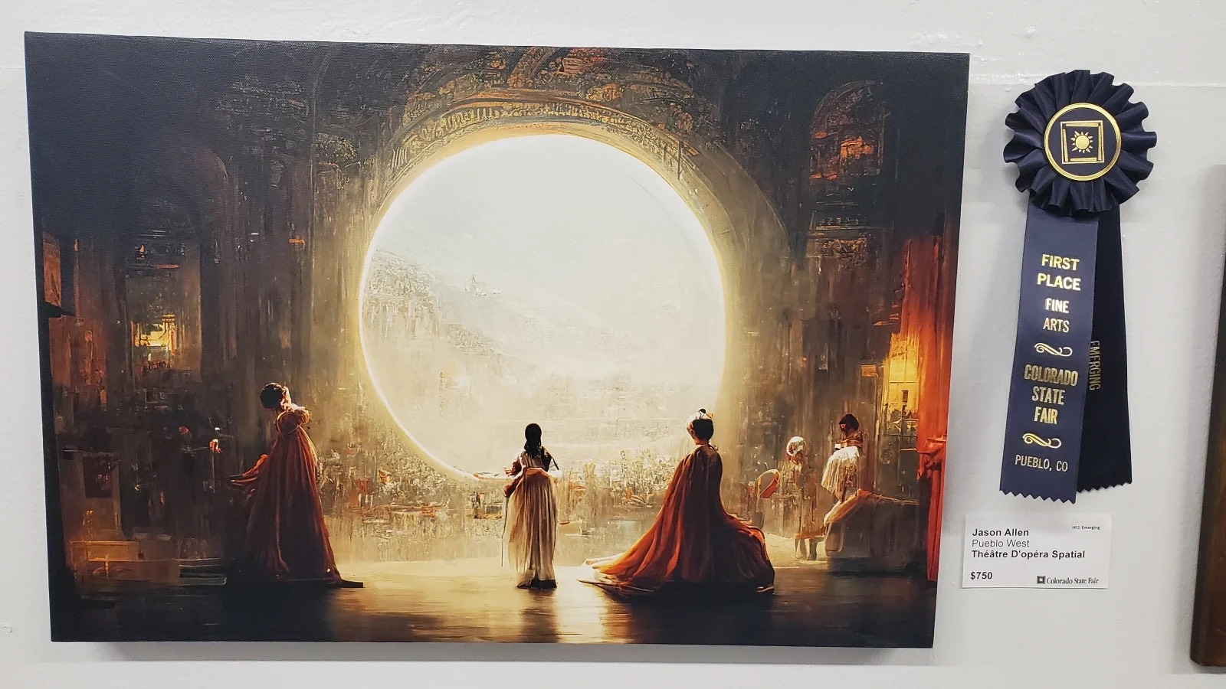
GenAI: Image
‘Space Opera Theater’
Co-created by Midjourney
‘The Electrician’
Co-created by DALL-E 2

